Slide 1
Human Computer Interaction
UE17CS424
Project Title : Music Planning
Project Team Members
TEJAS S SIRIGIRI PES1201802380
HRUSHIKESH H S PES1201802385

Slide 2
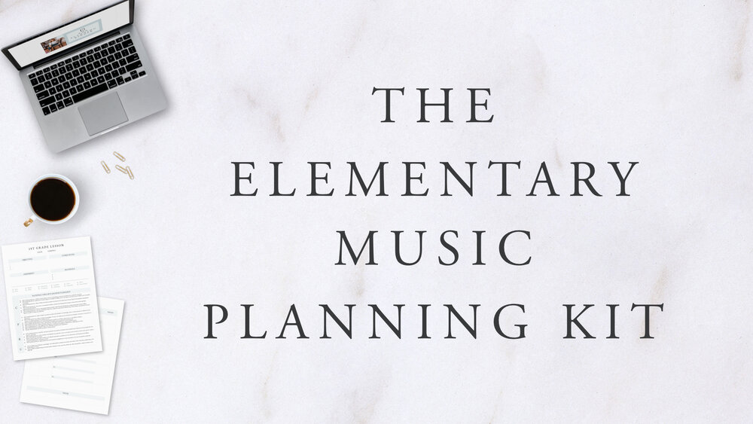
Concept

Slide 3
Contents
Concept Video
Need finding
Low Fidelity
1 Paper Prototype
2 Empathy Map
High Fidelity

Slide 4

Concept Video

Slide 5
Need Finding
First decide on how long you would like to practice for. Don’t start by aiming for marathon length practice sessions! Start with something you know you can manage. You can always lengthen the time of your practice in the future.
Having both short- and long-term goals will help you structure your practice so that you are always learning the things you need to in order to achieve your musical goals.
Greater Information density in the practice page is distracting for the user when practicing
The user’s experience with navigation within the app is a barrier to adoption of the app usage in practice sessions

Slide 6
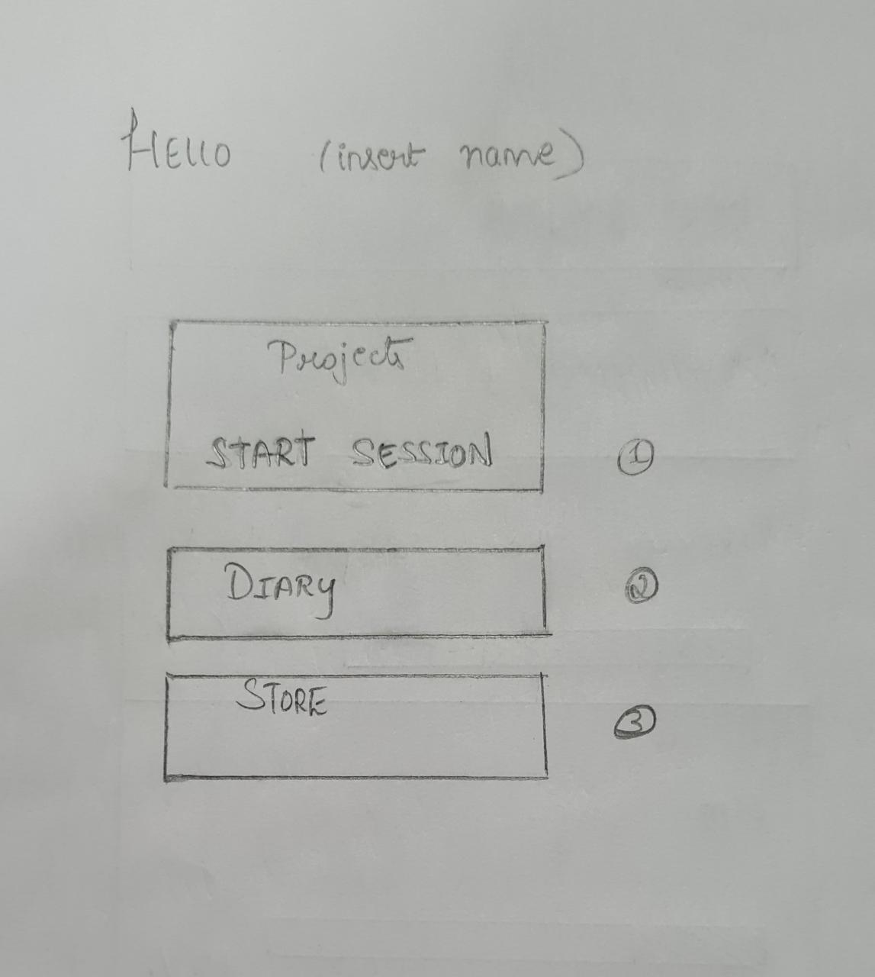
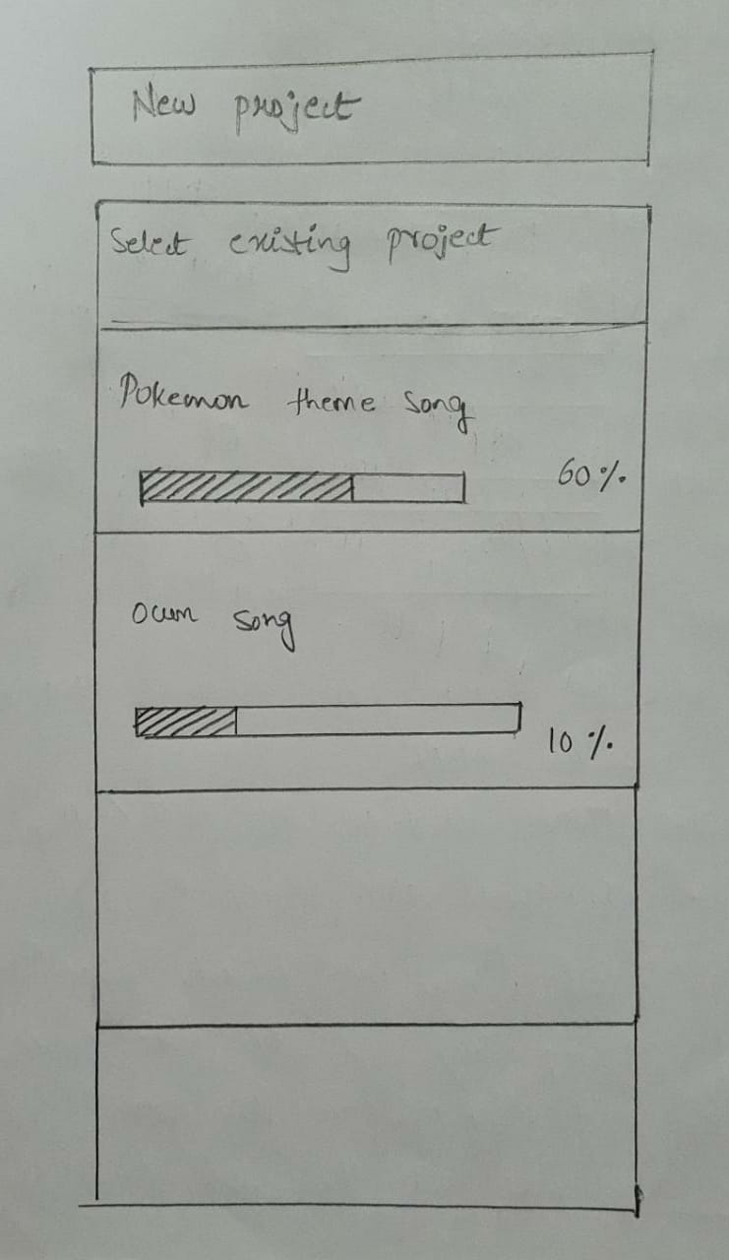
Paper Prototype

Slide 7
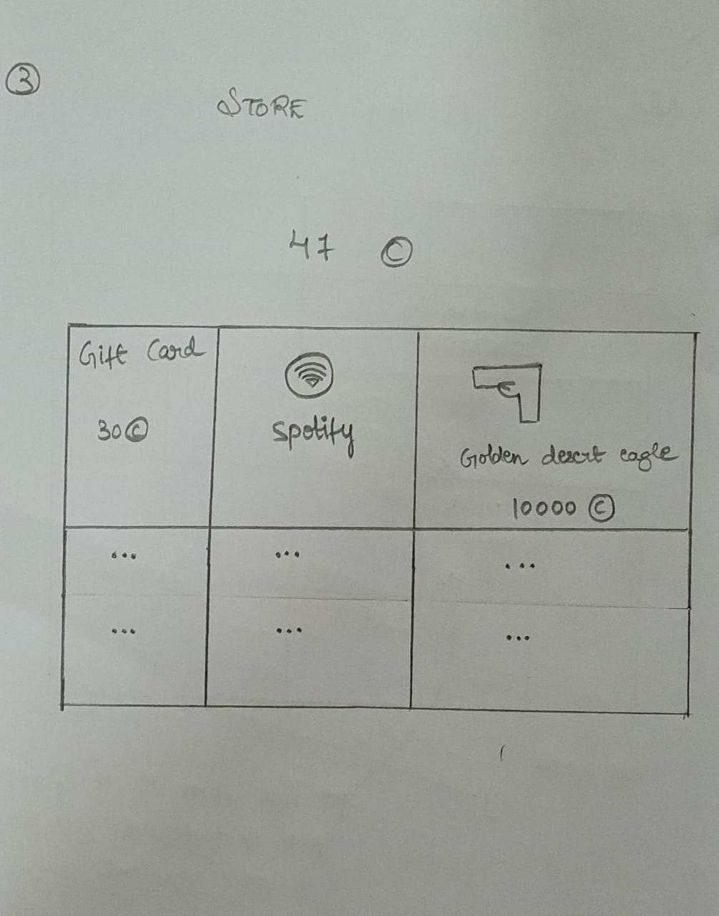
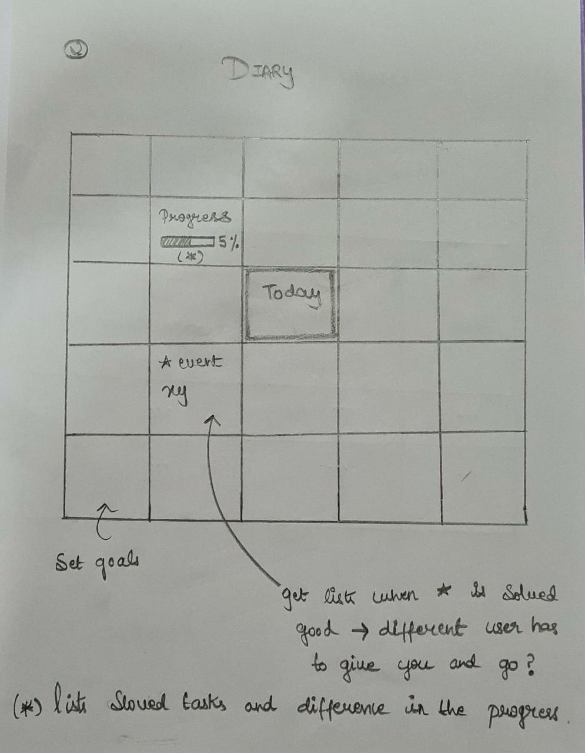

Slide 8
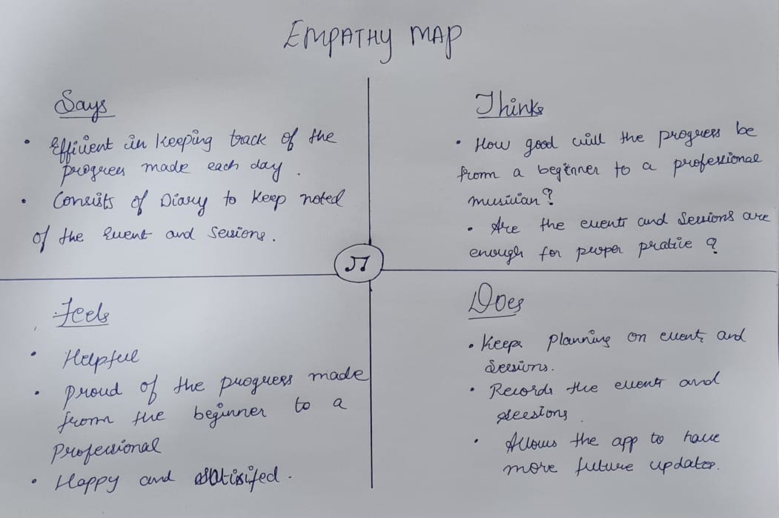
Empathy Map

Slide 9
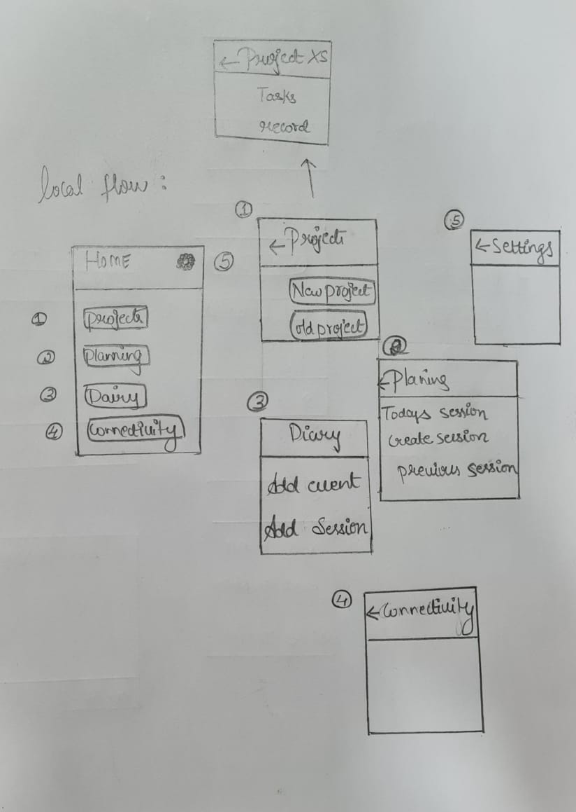
Local Flow

Slide 10
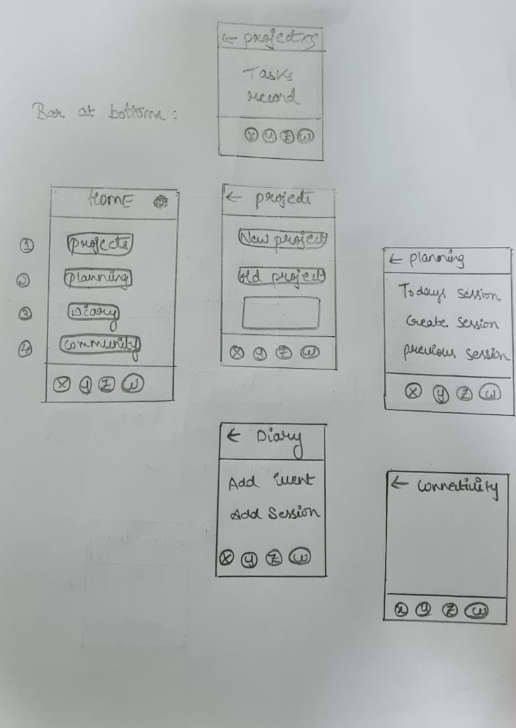
Bar at bottom

Slide 11
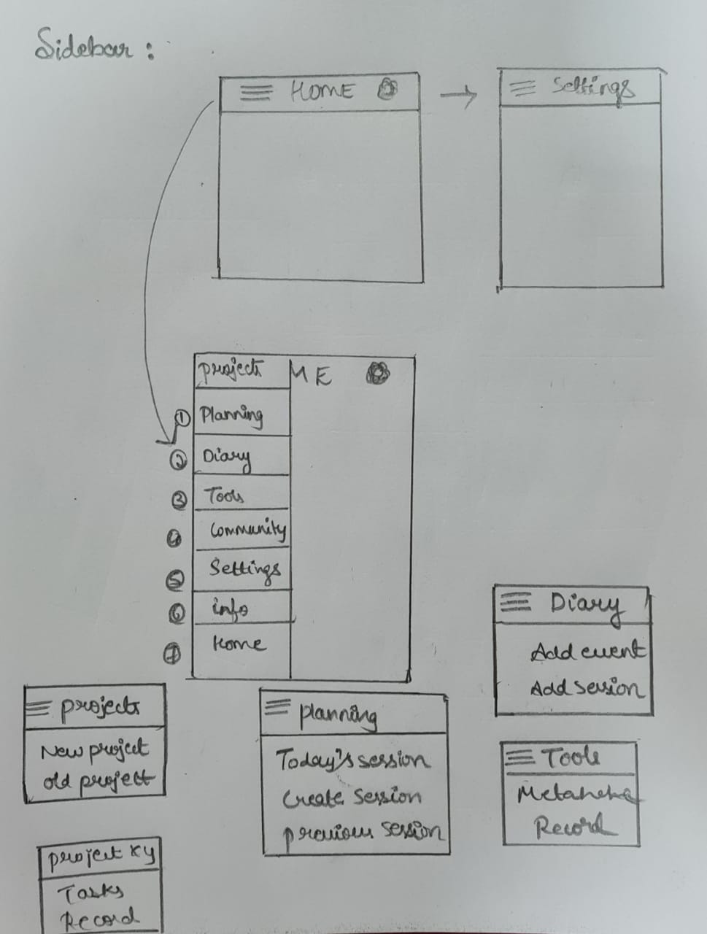
Side Bar

Slide 12
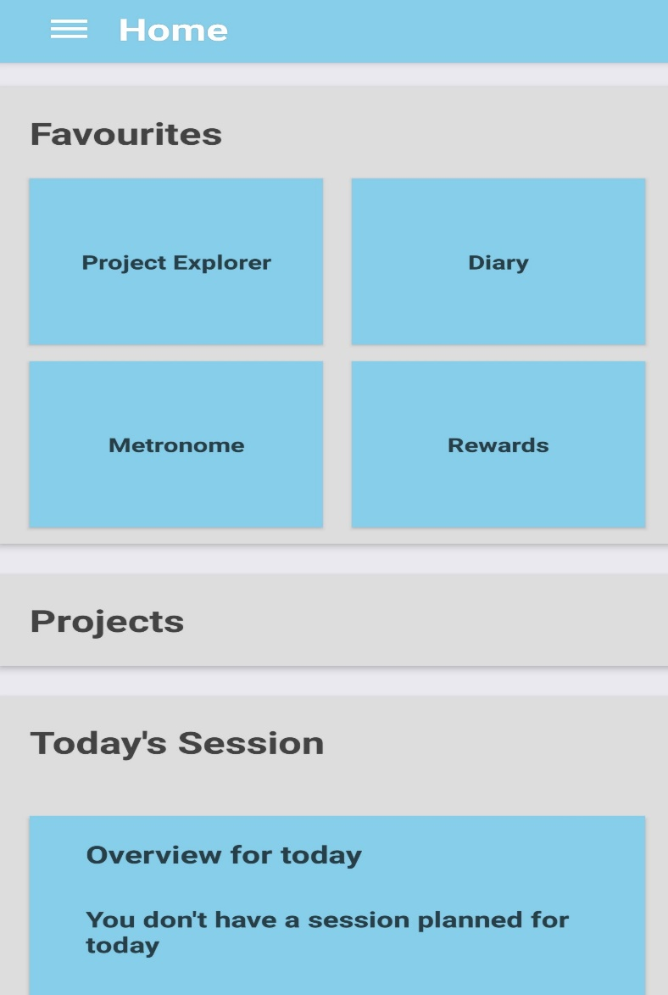
High Fidelity

Slide 13
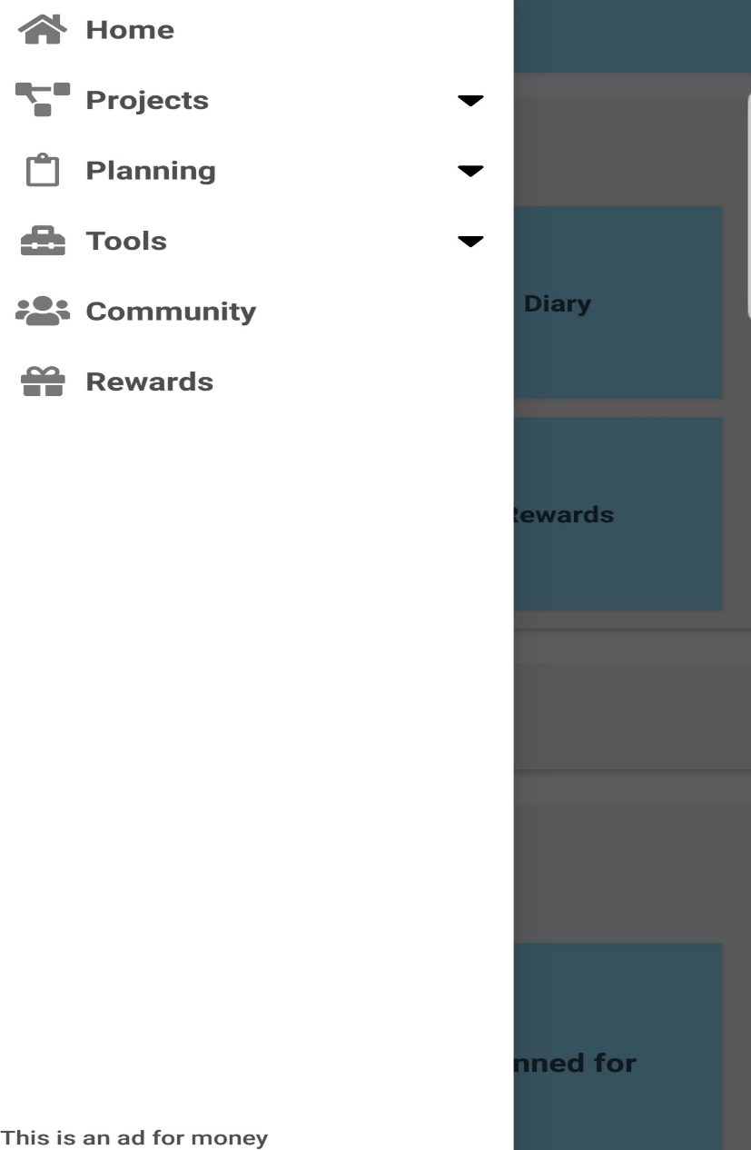

Slide 14
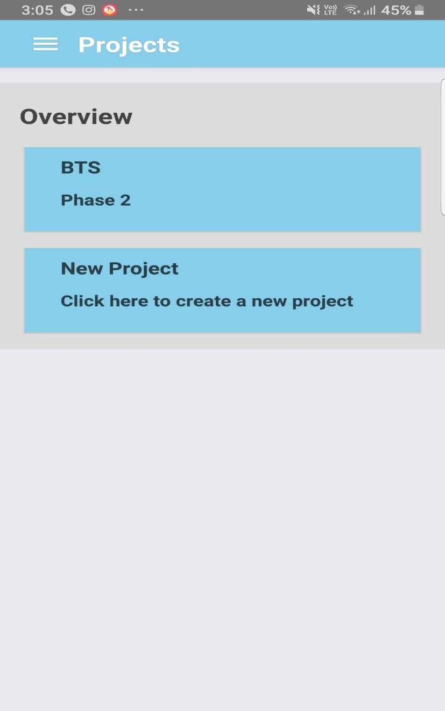
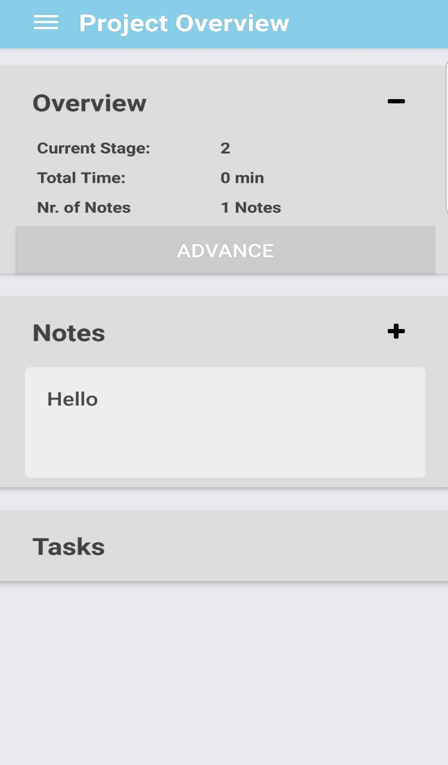

Slide 15
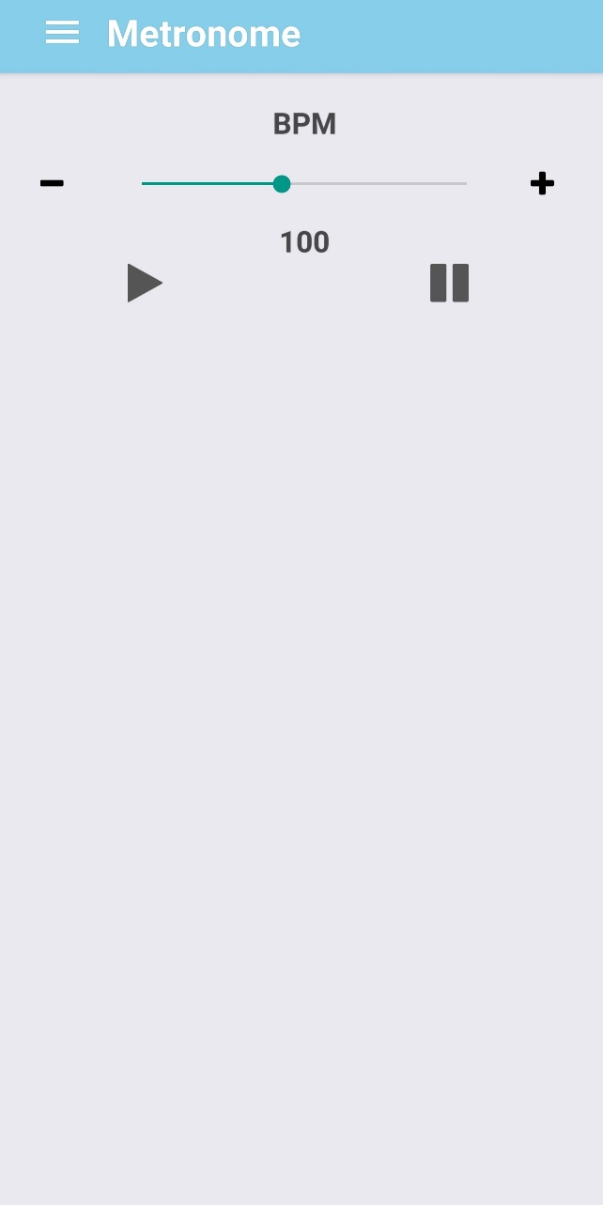
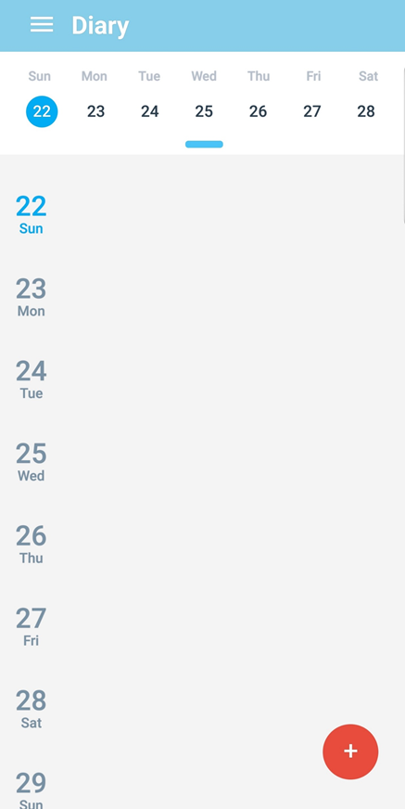

Slide 16
Thank You

